Slide 1
Informatica PowerCenter
Lesson 18: Incremental Aggregation

Slide 2
Lesson Objectives
In this Lesson you will learn about:
  What is incremental aggregation ?
  Understanding Incremental Aggregation Process
  Implementation – Sample mapping

Slide 3
18.1. Introduction To Incremental Aggregation
Using incremental aggregation, we apply captured changes in the source data (CDC part) to aggregate calculations in a session.
If the source changes incrementally and we can capture the changes, then we can configure the session to process those changes
This allows the Integration Service to update the target incrementally, rather than forcing it to delete previous loads data, process the entire source data and recalculate the same data each time you run the session.
INCREMENTAL AGGREGATION, may be helpful in cases when we need to load data in monthly facts in a weekly basis.
Note : Applicable if CDC ( Change data capture) is implemented
  Use incremental aggregation when the changes do not significantly change the target
Notes:
Use this mapping when you do not you need to keep any previous versions / history of dimensions in the table.

Slide 4
18.2. Understanding Incremental Aggregation Process
The first time we run an incremental aggregation session, the Integration Service processes the entire source.
At the end of the session, the Integration Service stores aggregate data for that session run in two files, the index file and the data file in the cache directory specified in the Aggregator transformation properties.
For next run Integration Service check if the CDC data from the source is existing in the index file and does the incremental aggregation and updates the index and data file accordingly.
Each subsequent time we run a session with incremental aggregation, the Integration Service creates a backup of the incremental aggregation files.
The cache directory for the Aggregator transformation must contain enough disk space for two sets of the files.
The Integration Service creates new aggregate data, instead of using historical data, when we configure the session to reinitialize the aggregate cache, Delete cache files etc.
When the Integration Service rebuilds incremental aggregation files, the data in the previous files is lost.
Note: To protect the incremental aggregation files from file corruption or disk failure, periodically back up the files.
Notes:
Use this mapping when you do not you need to keep any previous versions / history of dimensions in the table.

Slide 5
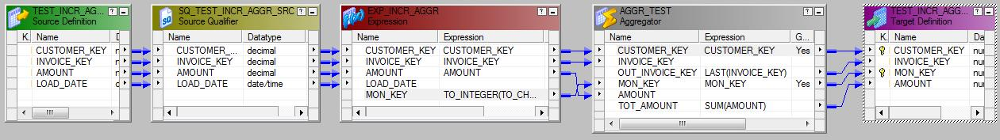
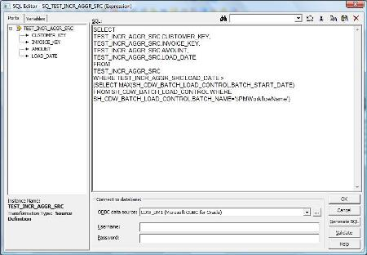
18.3. Implementation of Incremental Aggregation
Sample Mapping
CDC Source : Source query should fetch only the changed record . In below case , Batch Load Control table is used
Notes:
Use this mapping when you do not you need to keep any previous versions / history of dimensions in the table.

Slide 6
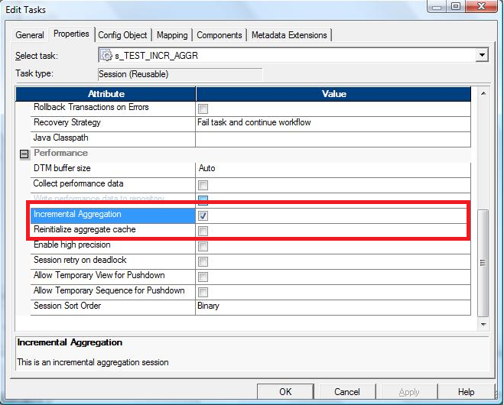
18.3. Implementation of Incremental Aggregation
Expression and Aggregate transform can have the desired logic
Session Configuration : Click check box of Incremental aggregate
If we want to reinitialize the aggregate cache suppose during first week of every month we will configure the same session in a new workflow at workflow level with the Reinitialize aggregate cache property checked in.
Notes:
Use this mapping when you do not you need to keep any previous versions / history of dimensions in the table.

Slide 7
18.3. Implementation of Incremental Aggregation
Example with Data :
Source data table
Target Table After 1st Weeks Load
CUSTOMER_KEY | INVOICE_KEY | AMOUNT | LOAD_DATE
1111 | 5001 | 100 | 01/01/2010
2222 | 5002 | 250 | 01/01/2010
3333 | 5003 | 300 | 01/01/2010
1111 | 6007 | 200 | 07/01/2010
1111 | 6008 | 150 | 07/01/2010
2222 | 6009 | 250 | 07/01/2010
4444 | 1234 | 350 | 07/01/2010
5555 | 6157 | 500 | 07/01/2010
CUSTOMER_KEY | INVOICE_KEY | MON_KEY | AMOUNT
1111 | 5001 | 201001 | 100
2222 | 5002 | 201001 | 250
3333 | 5003 | 201001 | 300
Notes:
Use this mapping when you do not you need to keep any previous versions / history of dimensions in the table.

Slide 8
18.3. Implementation of Incremental Aggregation
Now during the 2nd week load it will process only the incremental data in the source i.e those records having load date greater than the last session run date. After the 2nd weeks load after incremental aggregation of the incremental source data with the aggregate cache file data will update the target table with the following dataset:
CUSTOMER_KEY | INVOICE_KEY | MON_KEY | AMOUNT | Remarks/Operation
1111 | 6008 | 201001 | 450 | The cache file updated after aggretation
2222 | 6009 | 201001 | 500 | The cache file updated after aggretation
3333 | 5003 | 201001 | 300 | The cache file remains the same as before
4444 | 1234 | 201001 | 350 | New group row inserted in cache file
5555 | 6157 | 201001 | 500 | New group row inserted in cache file
Notes:
Use this mapping when you do not you need to keep any previous versions / history of dimensions in the table.

Slide 9
Summary
This Lesson gives knowledge incremental aggregation

Slide 10
Review Question
Is a pre-requisite for incremental aggregation
  SCD
  CDC
Cache file is recreated when incremental aggregation
check box is checked
  True
  False
Option B
Option B

